Slide 1
Presentation brief for MCT’s
Title of presentation | Enhancing Bots with QnA Maker
Presentation length | 60 minutes.
Audience | Azure AI Engineers, Azure Developers.
Purpose | Introduce QnA Maker Understand QnA Maker Knowledge Bases Understand how to integrate QnA Maker and Bots
(think) Student key takeaways | The student should understand what the QnA Maker is The student should understand the concept of Knowledgebases in a QnA Maker The student should understand how to integrate QnA Maker and a Bot
(feel) Student desired mindset | The student should understand how QnA Maker simplifies the process of creating Bot interactions
(do) Student outcomes | The student should be able to create QnA Maker service The student should be able to create a knowledgebase The students should be able to integrate QnA Maker with a Bot
More information | For course feedback, please use the MCT forums

Slide 2

AI-100T01A Module 03: Enhancing Bots with QnA Maker

Slide 3
Agenda
Introducing the QnA Maker Service
Implement a Knowledge Base for QnA Maker
Integrate QnA Maker with a Bot
Lab: Integrating Bots and QnA Maker

Slide 4



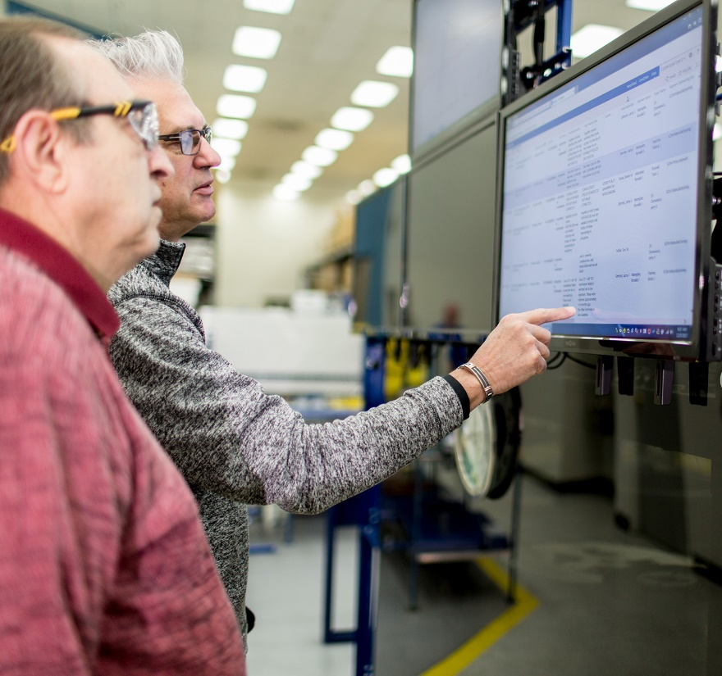



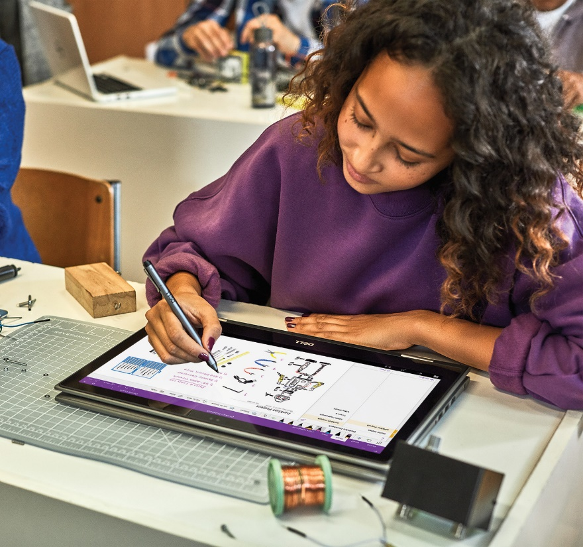


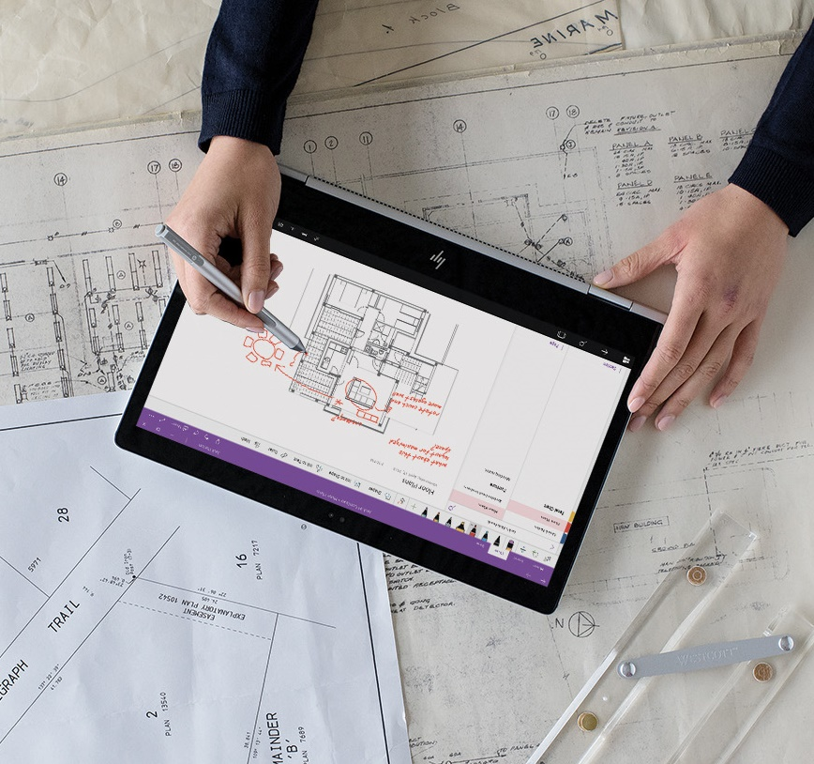


Lesson 01
Introducing QnA Maker
Data
Cloud
AI

Slide 5
Lesson Objectives
L01 – Introduce QnA Maker
L02 – Guided walkthrough, Creating a QnA Maker Service

Slide 6
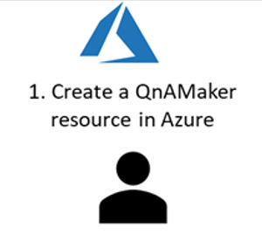
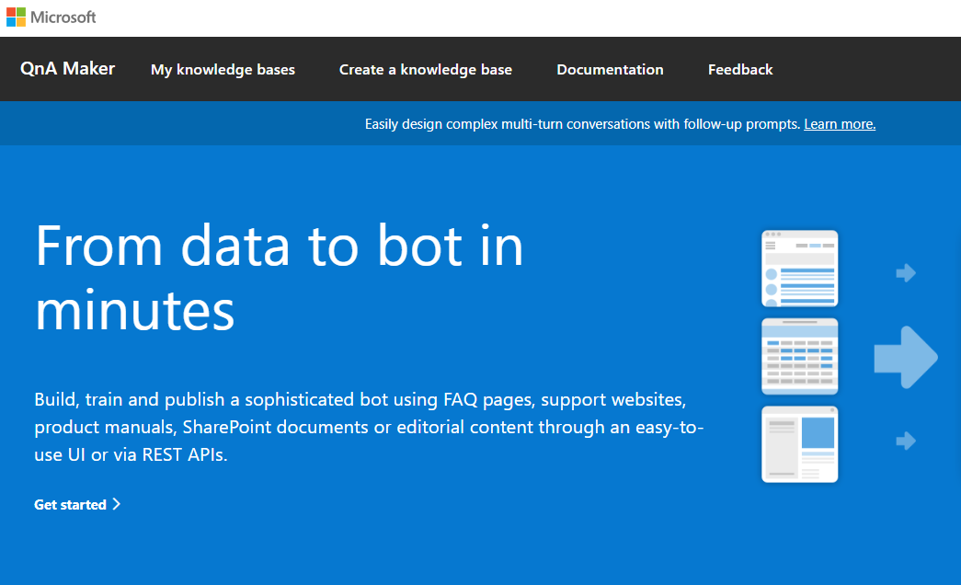


Overview
2. Sign into QnA Maker Portal https://qnamaker.ai
3. Create a knowledge base of QnA pairs
4. Integrate with a Chat Bot for automated response capabilities

Slide 7
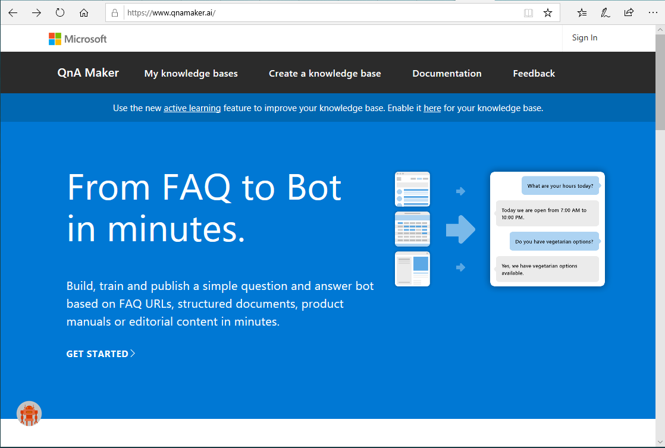
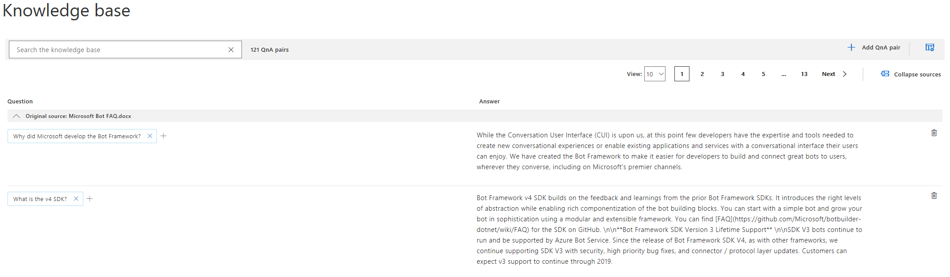
QnA Maker Service

Slide 8
Walkthrough – Create a QnA Service

Slide 9
Lesson 02
Implementing a Knowledge Base with QnA Maker
Data
Cloud
AI

Slide 10
Lesson Objectives
L01 – Understand Knowledge Base Concepts
L02- Explore Data Sources for a Knowledge Base
L03 – Create a Knowledge Base
L04 – Integrate the Knowledge Base with QnA Maker
L05 – Publish and Test a Knowledge Base

Slide 11
Creating a Knowledge Base
Three base-level concepts are:
Questions - these are what you expect a user to ask. Questions will be paired with answers
Answers - the response that will be returned when a user asks a question. The answer is paired to a question in the knowledge base
Metadata - these are tags associated with the question and answer pair. Internally they are represented as key-value pairs and filter the QnA pairs for matching a user query.

Slide 12
Knowledge Base Potential Data Sources
URLs - can contain the following types of information
FAQs - (Flat, with sections or with a topics homepage)
Support pages - (Single page how-to articles, troubleshooting articles etc.)
PDF
FAQs
Product Manual
Brochures
Paper
Flyer Policy
Support guide
Structured QnA
DOC
FAQs
Product Manual
Brochures
Paper
Flyer Policy
Support guide
Structured QnA
Excel - Structured QnA file (including RTF, HTML support)
TXT/TSV Files - Structured QnA file

Slide 13
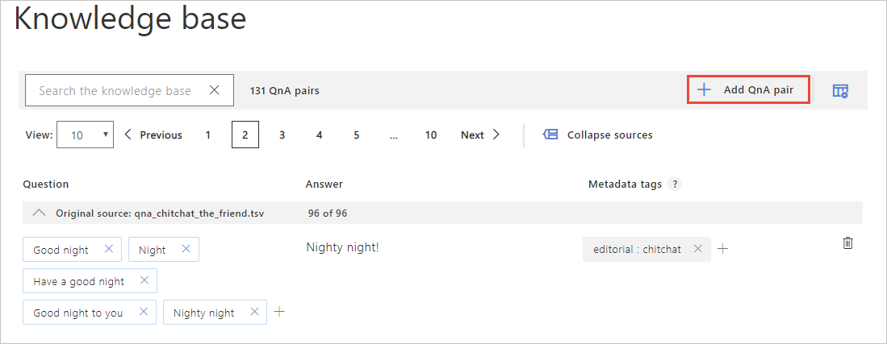
Creating a Knowledge Base
Add Question and Answer Pairs Manually
When creating your knowledge base for QnA Maker, be sure to follow the [best practices](https://docs.microsoft.com/en-us/azure/cognitive-services/qnamaker/concepts/best-practices) described by Microsoft.

Slide 14
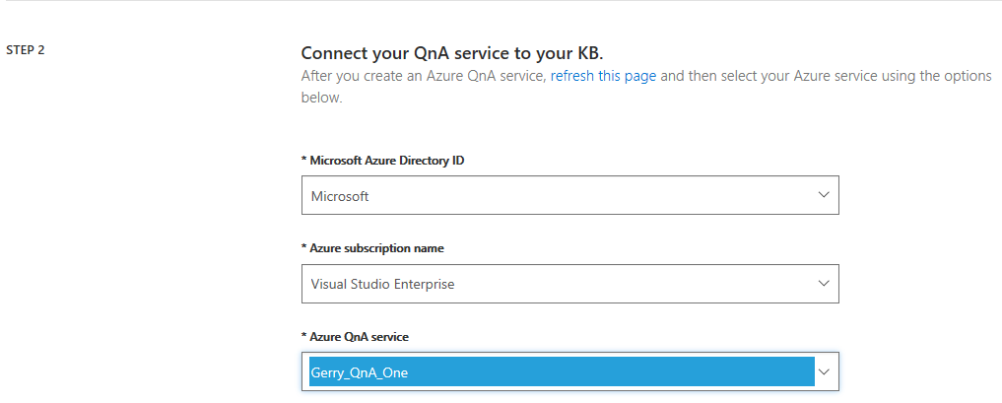
Adding a Knowledge Base to your QnA Service

Slide 15
Walkthrough - Add a KB to your QnA Service

Slide 16
Publishing Knowledge Base
Review and edit this page prior to publishing your knowledge base. You can perform the following editing options:
Add questions related to an answer - immediately to the right if each question is an X that you can use to delete a question but also a plus (+) symbol that you can use to add additional questions, related to the answer found in the answer column. Recall that you can have the same answer related to multiple questions in an effort to ensure coverage for anticipated questions that are similar
Delete an answer - you can click the trash can icon next to an answer to delete a question/answer pair
Add QnA Pair - clicking this button, found above the page navigation arrows, allows you to add a new question and answer pair to knowledge base. You would do this if your source document didn't contain all the QnA pairs you need, or to augment the existing list with some new data.
Show Metadata Tags - initially your QnA pairs may not have any metadata associated with them, clicking the Show metadata tags icon, will display any metadata tags associated with each QnA pair

Slide 17
Walkthrough – Test and Publish Knowledge Base
Notes:
Work with the students to complete both the test and publish walkthroughs

Slide 18
Lesson 03
Integrate a Bot and QnA Maker
Data
Cloud
AI

Slide 19
Lesson Objectives
L01 – Understand how to Integrate Bots and QnA Maker
L02 – Guided Walkthrough, Integrate QnA Maker and a Bot

Slide 20
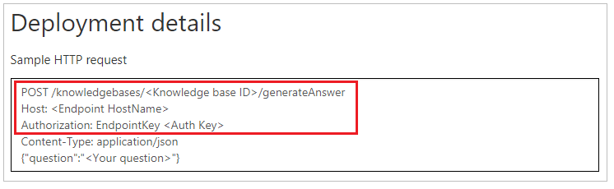
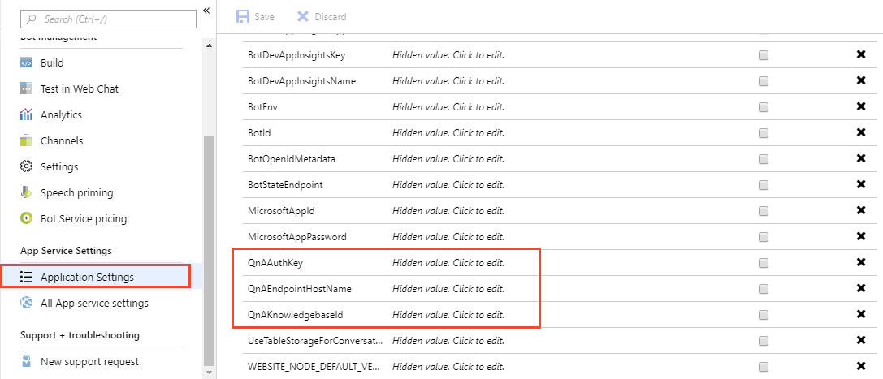
Integrating Bots and QnA Maker

Slide 21
Walkthrough – Integrate your KB with a Web App Bot

Slide 22

Lab 5: Integrate QnA Maker with a Bot (COMING SOON)

Slide 23
Lab Objectives
Create a QnA Service
Generate a Knowledge Base using a PDF Document (FAQ)
Connect and Publish the Knowledge Base
Connect the QnA Service to a Bot

Slide 24
Lab Scenario
AdventureWorks wants to use a Bot to allow their customer support FAQ to drive conversations on a Customer Support Bot. A document already exists that contains some questions and answers taken from the FAQ engagements with customers. This will serve as a starting point but may need to be augmented with additional questions and answers.

Slide 25

Next steps
Module Summary
In this module, you have learned about:
Microsoft QnA Maker
Knowledge Bases for use with QnA Maker
How to Publish and Test a Knowledge Base
How to Integrate it with a Bot
After the course, consider researching the QnA Maker documentation around the different data source formats that are supported in creating knowledge bases for QnA Maker.

